Slide 1

Fog Computing
… Cloud Computing at the Edge of the Network
https://commons.wikimedia.org/wiki/File:Golden_Gate_Bridge_fog_2014.jpg

Slide 2
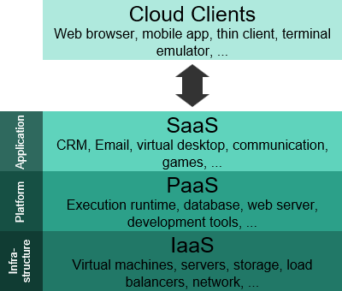
Cloud Computing
AWS definition:
The on-demand delivery of compute power, database storage, applications, and other IT resources through a cloud services platform via the internet with pay-as-you-go pricing.
OPEX – operational expense model
https://commons.wikimedia.org/wiki/File:Cloud_computing_layers.svg

Slide 3
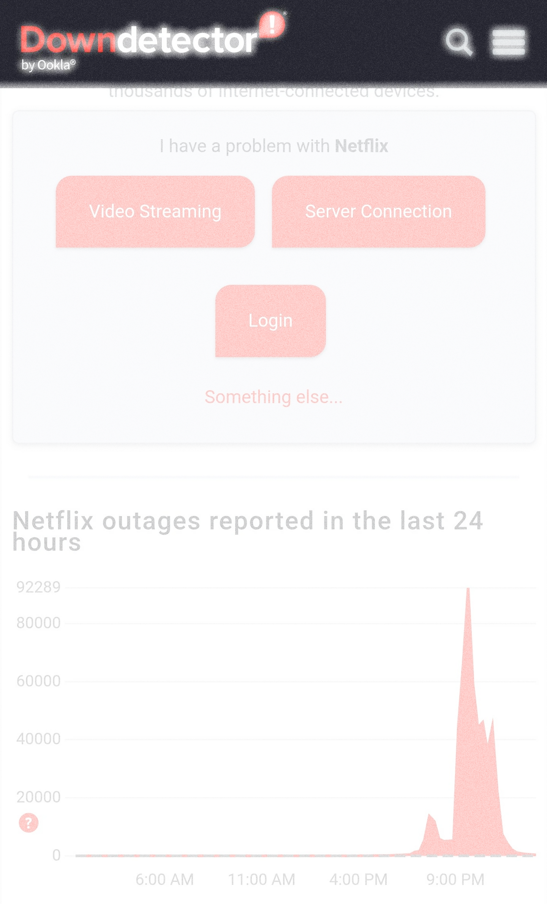
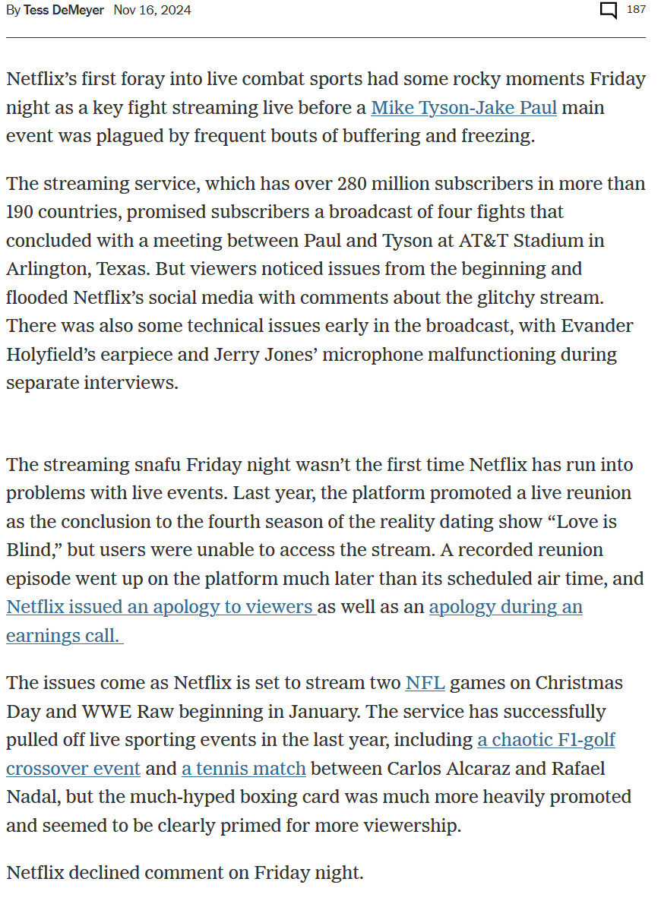
Why isn’t Cloud Computing sufficient for some applications?
https://www.nytimes.com/athletic/5925844/2024/11/16/netflix-buffering-freezing-jake-paul-mike-tyson/

Slide 4
The Edge of the Cloud
Why isn’t cloud computing sufficient for some applications?
  Latency – Real-time interaction
    Video Streaming – Movies, Video Conferencing
    Gaming – Role playing games
    Augmented Reality – Pokémon Go
  Geographical Distribution – Widely distributed deployments
    Massively Multiplayer Online Real-time Games
    Route Planning / Traffic
  Mobile Deployment – Nodes will be moving
    Cell phones
    Vehicles
  Large number of Nodes
    Networks of sensor nodes

Slide 5
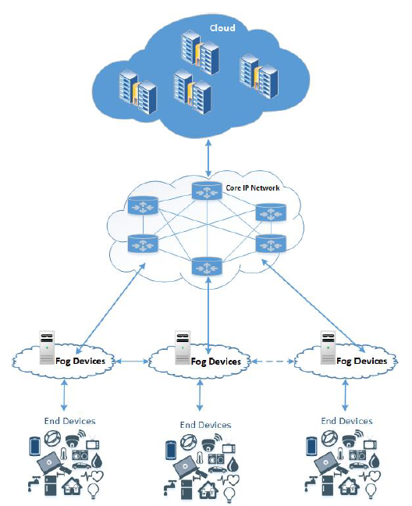
Fog Computing
Fog platform provides low-latency virtualized services and is linked to the Cloud Computing infrastructure.
Edge devices request compute, storage and communication services from the Fog. The Fog provides local, low-latency response to these requests and forwards relevant data for computationally intensive processing.
Fog Computing: Survey of Trends, Architectures, Requirements, and Research Directions

Slide 6
Exemplars: Content Delivery
Netflix – evolving business model.
  1998: Initially mail order DVDs, competing with Blockbuster brick and mortar stores.
    Order on-line
    DVDs delivered by mail
  2007: Started deliver content via internet
  2011: Development of Open Content Delivery – a network set up to move content closer to the consumer
  Business Model:
    Subscription Service
    Delivery of the content you want, when you want it.
    Cloud computing supported– Billing, Content Delivery Network, big data analytics, understanding usage patterns and where content needs to be placed for fast delivery.
Notes:
Push content closer to consumer – reduce latency and performance
Risks – security, servers residing outside your direct sphere of influence
-- Synchronization problems, not so much a problem for a video, but potential issue for gaming

Slide 7
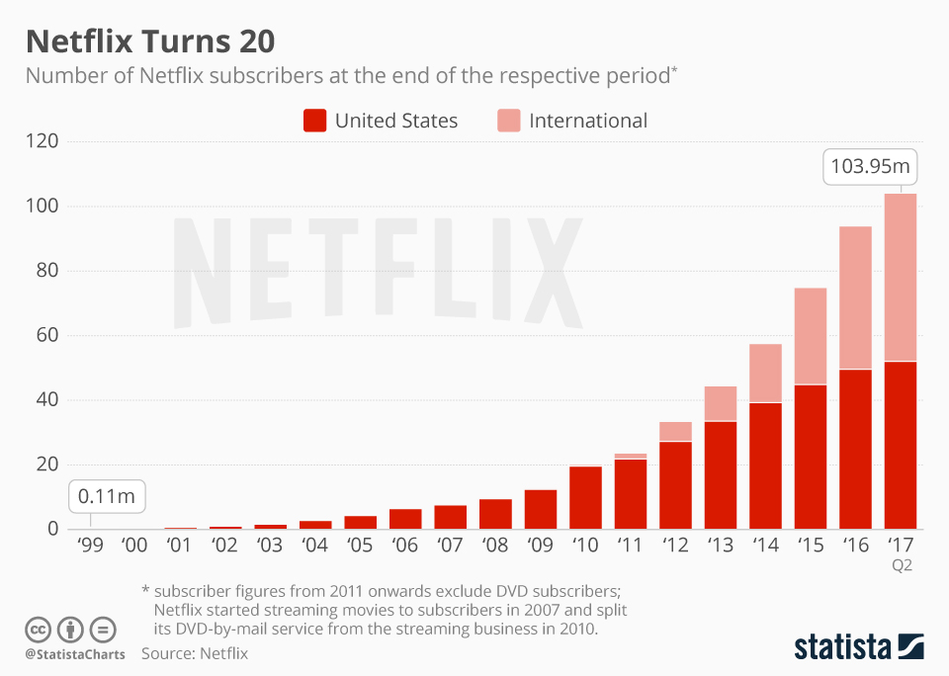
How do you scale this?
Back Office Support can still be done in the cloud.
But how do you do content delivery?
Notes:
2022Q3: 223 million subscribers

Slide 8
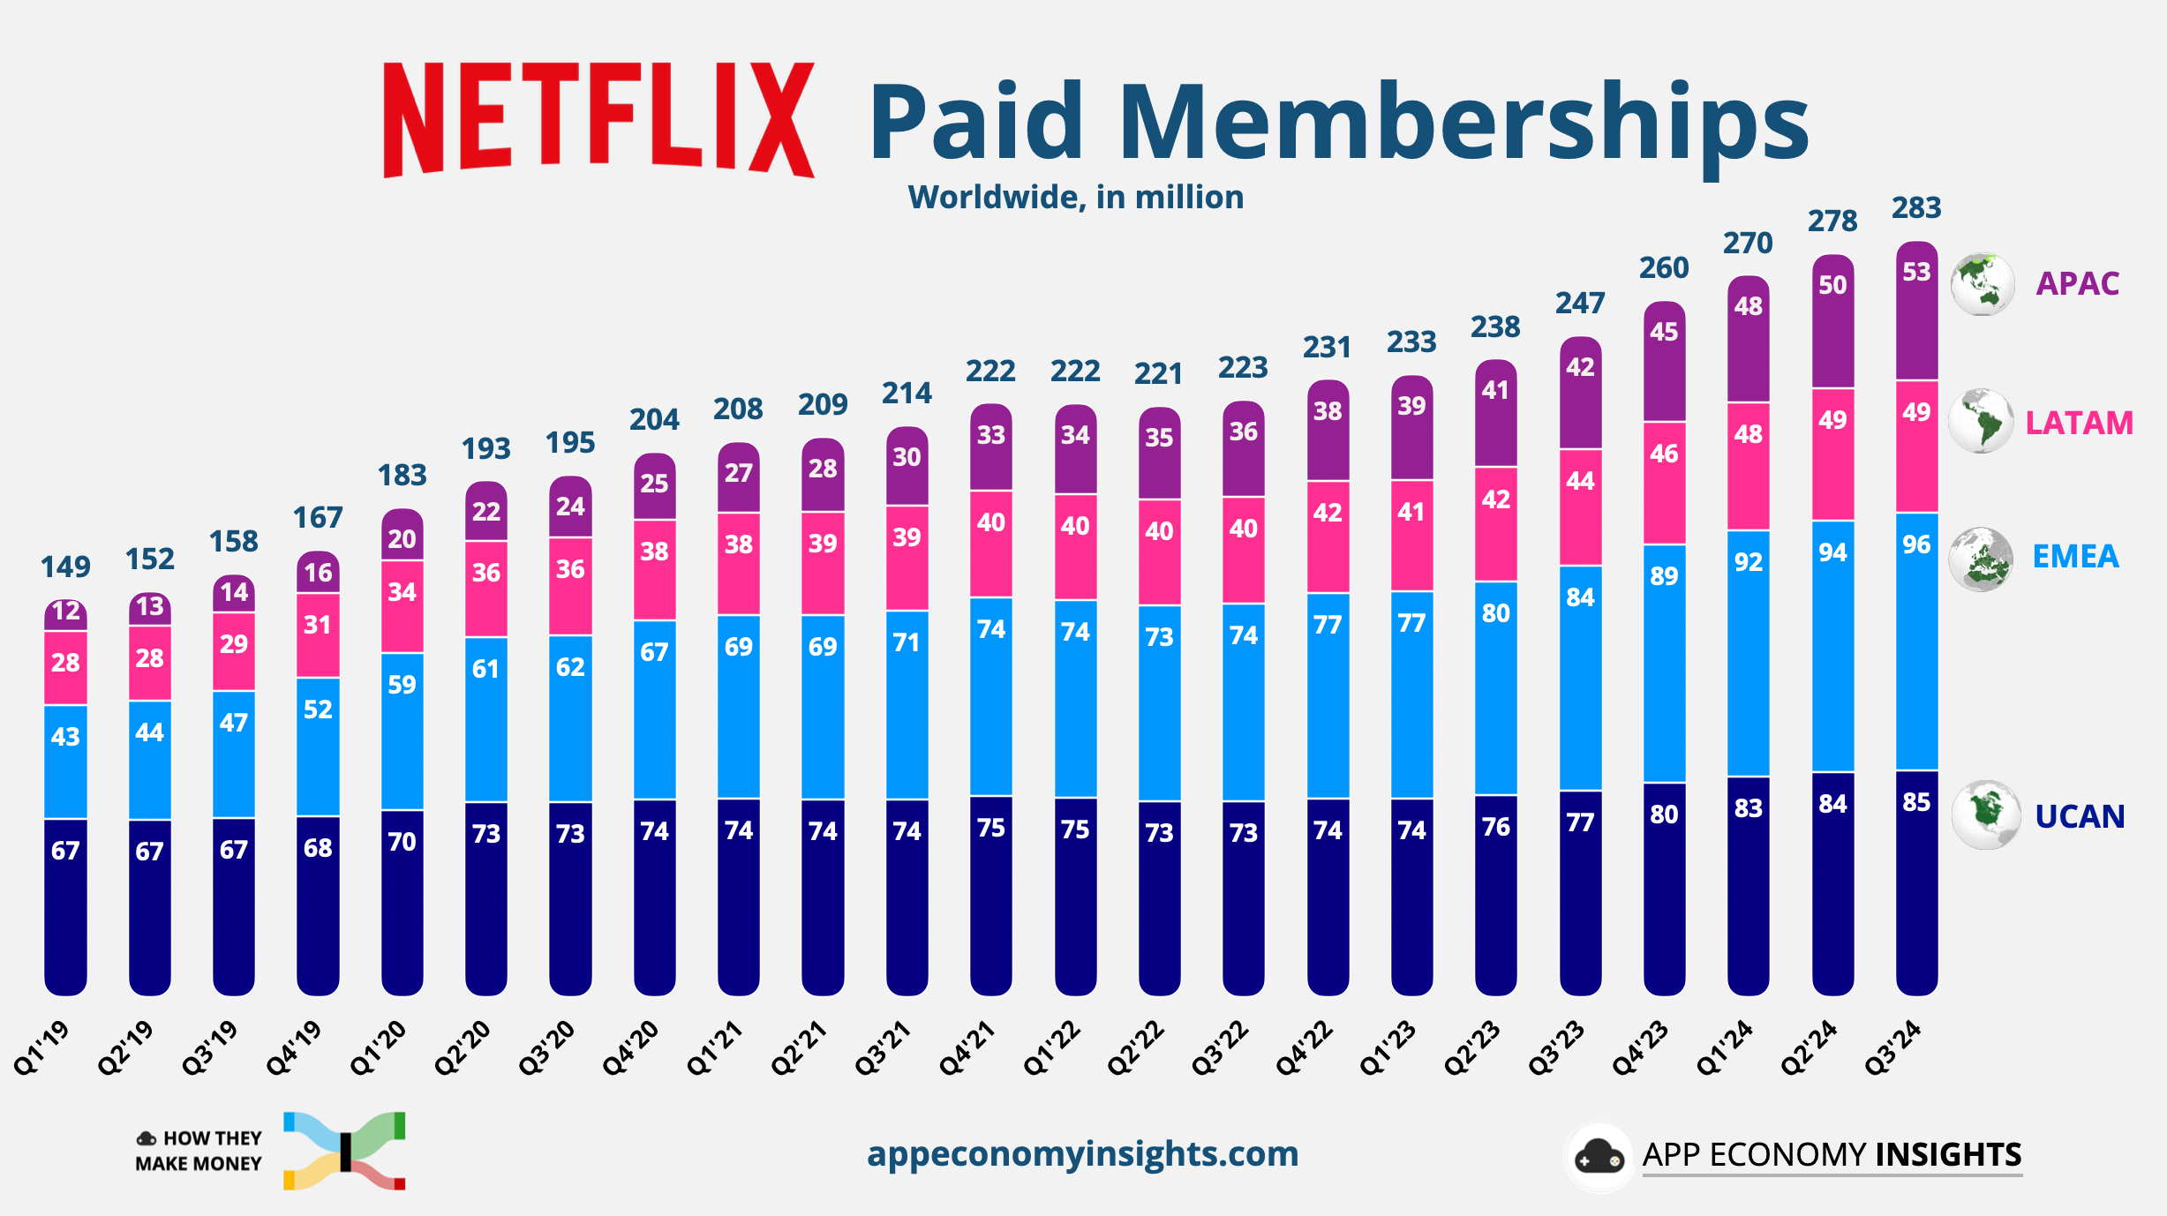
2024

Slide 9
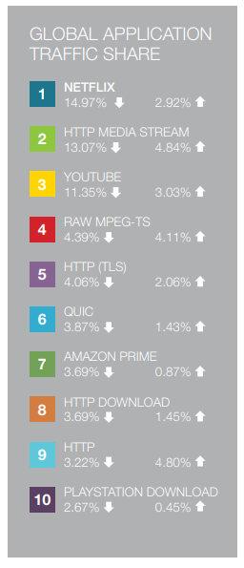
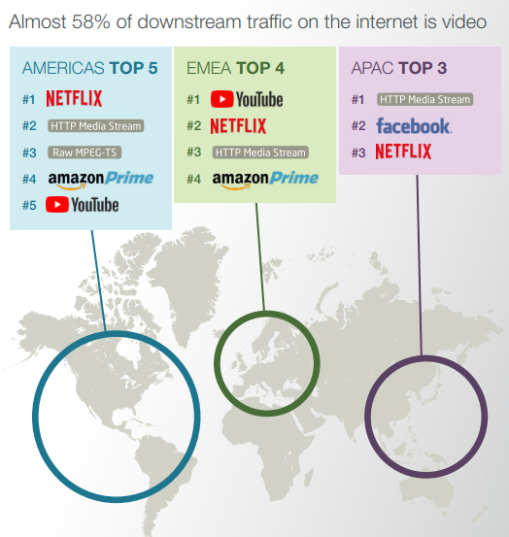
https://www.sandvine.com/hubfs/downloads/phenomena/2018-phenomena-report.pdf
Notes:
2021 – video accounted for 53.72% of downstream traffic.

Slide 10
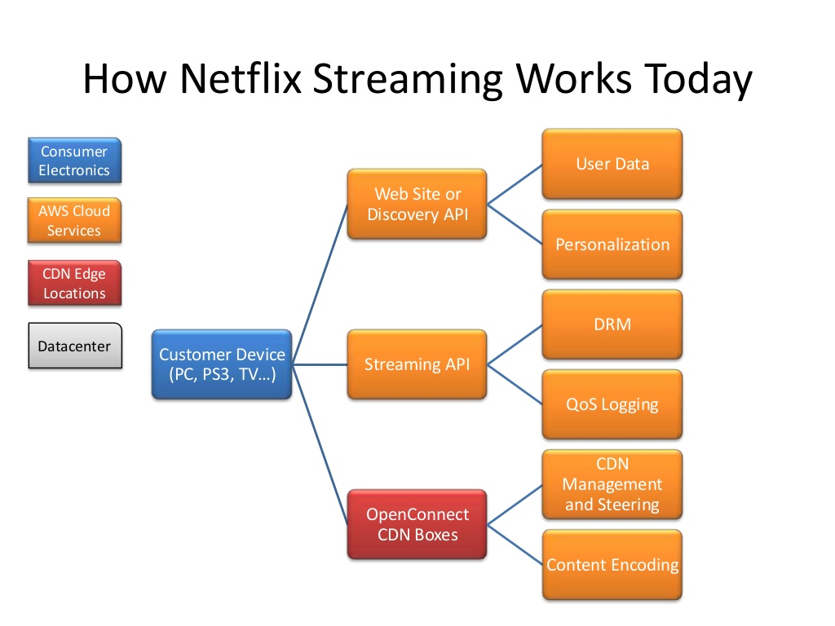
Yow Conference Dec 2013 Netflix Workshop

Slide 11
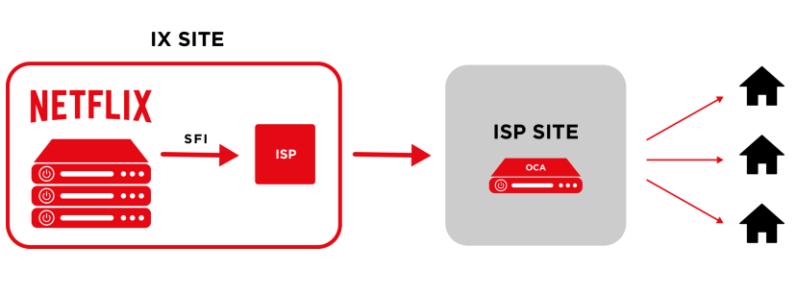
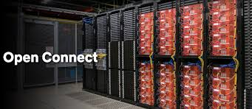
Netflix
IX – Internet Exchange Points
SFI – Settlement Free Peering
OCA – Open Connect Appliance

Slide 12
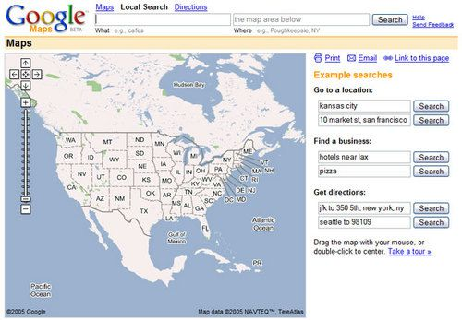
Exemplars: Real-time Mapping
Initially, Maps were static. You generated a map with directions and printed it.
2005: Google Maps introduced.
2007: Real-time traffic data integrated
2007: Street View added
2008: Android App released w/ turn by turn navigation
Interesting article about putting the data into Google Maps:
  How Google Builds Its Maps
Notes:
Luc Vincent – Google, pioneered Street View

Slide 13
Fog Computing Characteristics:
  Low Latency – Video Delivery, Navigation Information
  Location Awareness – Traffic Lights, Navigation, Sensor Networks
  Wide-spread Geographical Distribution
  Mobility – Fitness Trackers, Phones and Vehicles

Slide 14
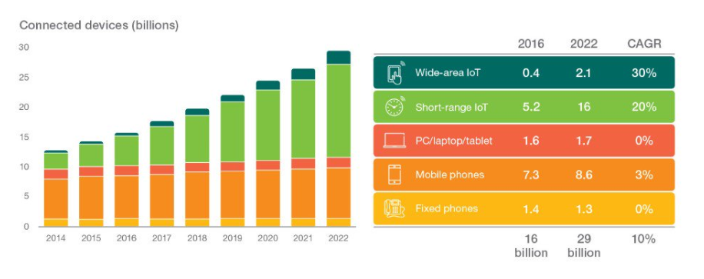
Fog Computing Characteristics:
  Very Large Number of Nodes
IoT Device Connections
https://d110erj175o600.cloudfront.net/upload/images/06_2017/170615153722.pdf
Notes:
CAGR = Compound Annual Growth Rate

Slide 15
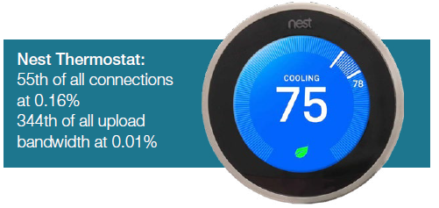
Fog Computing Characteristics:
  Predominance of Wireless Access
  Strong presence of Streaming and Real-time Applications
  Heterogeneity
www.sandvine.com/hubfs/downloads/phenomena/2018-phenomena-report.pdf

Slide 16
Architectural Drivers
Low Latency / Real Time Response – Device will want near real-time response for content delivery and actionable information
Dynamic Number of Nodes -- Number of devices within the Fog is dynamic. System must be able to handle large number of devices joining and leaving the Fog
Highly Mobile Nodes – Nodes will be entering and exiting the Fog and the Fog must adapt and continue to perform
Diverse Set of Failure Modes – Wide range of devices with varying levels of sophistication mean there will be many failure modes that need to be seamlessly handled
Security – Access control
Notes:
Issues to think about – Security & data synchronization

Slide 17
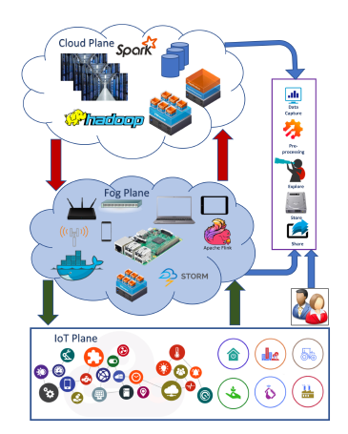
Layered Pattern for Fog Computing:
Fog Computing: Survey of Trends, Architectures, Requirements, and Research Directions

Slide 18
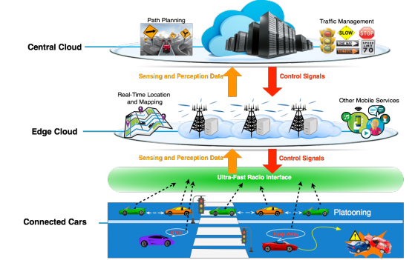
https://arxiv.org/pdf/1701.01090.pdf

Slide 19
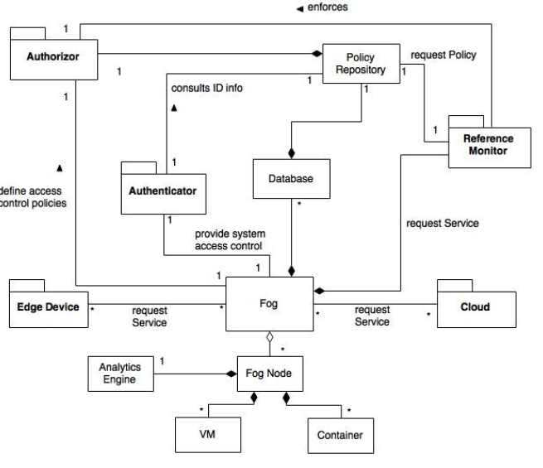
Fog Computing Pattern:
A Pattern for Fog Computing

Slide 20
Reading Assignment:
A Pattern for Fog Computing: https://www.researchgate.net/publication/314101893_A_Pattern_for_Fog_Computing
Be prepared to address a couple questions about this paper on Friday, November 13.

